Slide 1
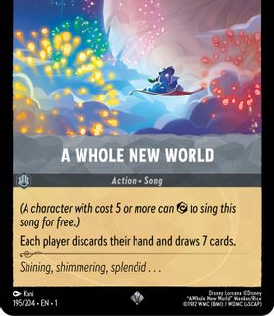
A Whole New World
(an analytical dive into my new hobby...oof)

Slide 2
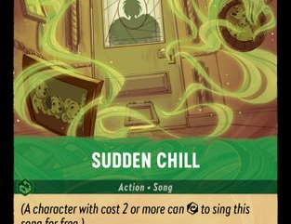
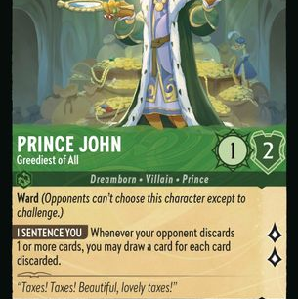
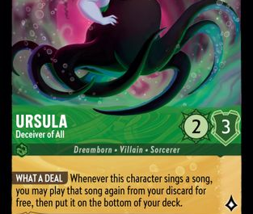
Question:
I primarily play a green/grey discard/control deck. Are specific colors better against me, or am I just bad?

Slide 3
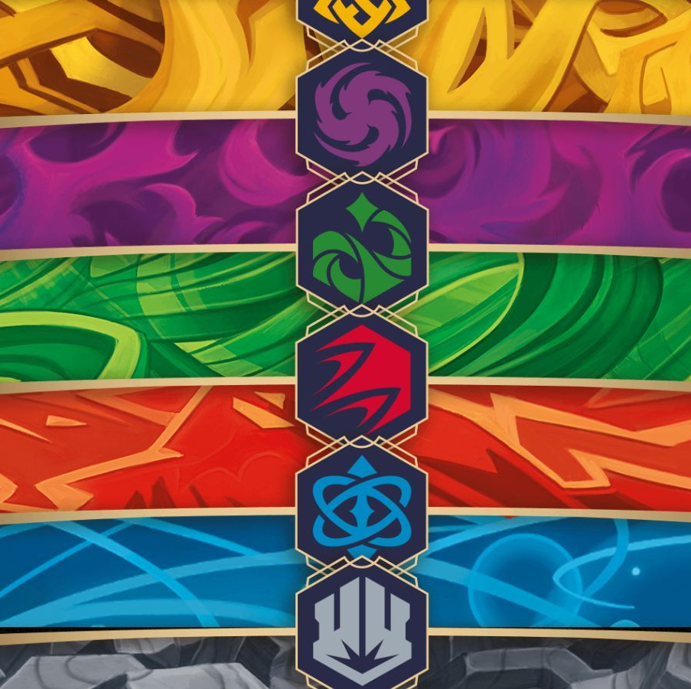
Data Collection: method and observations
I recorded my wins and losses against decks I played online in preparation for a tournament I was to participate in on April 20th from April 1st to April 13th.
The variables of this test were the different colors:
Green, Grey, Blue, Yellow, Red, Purple

Slide 4
 |  | Win | Loss | Win | Loss | Win | Loss | Win | Loss | Win | Loss | Win | Loss | Win | Loss | Win | Loss | Win | Loss | Win | Loss | Win | Loss | Win | Loss | Win | Loss | Win | Loss | Win | Loss
 | Color 1 | Red | Red | Red | Red | Red | Red | Red | Red | Red | Red | Blue | Blue | Blue | Blue | Blue | Blue | Blue | Blue | Green | Green | Green | Green | Green | Green | Yellow | Yellow | Yellow | Yellow | Purple | Purple
Date | Color 2 | Blue | Blue | Green | Green | Yellow | Yellow | Purple | Purple | Grey | Grey | Green | Green | Yellow | Yellow | Purple | Purple | Grey | Grey | Yellow | Yellow | Purple | Purple | Grey | Grey | Purple | Purple | Grey | Grey | Grey | Grey
1-Apr-24 |  | 10 | 6 | 1 |  | 3 |  | 5 | 2 |  |  |  |  |  |  |  |  | 4 | 2 |  | 1 | 1 | 2 | 3 | 1 | 2 |  | 2 | 1 | 2 | 1
2-Apr-24 |  | 3 | 2 |  |  | 4 |  | 3 | 1 |  |  | 1 |  |  |  |  |  | 1 |  | 1 |  |  |  | 1 | 1 | 1 |  | 3 | 2 | 1 | 1
3-Apr-24 |  | 1 | 3 |  |  |  | 2 | 2 | 2 |  |  |  |  | 1 |  |  |  | 2 | 2 |  | 1 |  |  | 3 | 2 | 3 | 2 | 4 | 3 | 4 | 1
4-Apr-24 |  | 3 | 4 |  |  |  |  | 4 | 4 | 2 |  | 1 | 1 |  |  |  | 1 | 4 | 3 |  |  |  |  | 4 | 3 | 1 | 1 | 1 | 2 | 1 | 2
5-Apr-24 |  | 6 | 2 | 1 |  |  | 2 | 3 | 1 | 1 |  |  |  |  |  |  |  | 2 | 4 |  |  | 1 | 2 | 1 | 4 |  | 1 | 2 | 3 |  | 2
6-Apr-24 |  | 4 | 1 |  |  | 1 |  | 2 | 2 |  | 3 | 1 | 1 |  |  | 1 | 1 | 3 | 1 | 1 |  |  |  | 4 | 3 | 1 |  | 1 | 1 | 1 | 1
7-Apr-24
8-Apr-24 |  | 7 | 3 |  |  |  | 1 | 5 | 2 |  | 1 |  |  | 1 | 1 |  |  | 3 | 3 | 2 | 1 |  |  | 3 | 4 | 1 |  | 1 | 1 |  | 1
9-Apr-24 |  | 1 |  |  |  | 2 |  | 3 | 1 | 1 | 2 |  |  | 1 |  |  |  | 1 | 3 |  |  | 1 | 1 | 2 | 3 |  | 1 | 2 | 2 | 1 | 2
10-Apr-24 |  | 2 | 1 |  |  |  | 3 | 2 |  | 2 | 1 |  | 1 |  |  | 1 |  | 2 | 2 |  |  |  | 1 | 1 | 2 | 2 |  | 1 | 1 | 1
11-Apr-24 |  | 1 | 1 |  |  |  | 1 | 4 | 1 |  |  |  |  |  |  |  |  | 3 | 2 |  |  |  | 1 |  | 1 |  |  | 1
12-Apr-24 |  | 1 |  |  |  |  |  |  |  |  | 1
13-Apr-24
Total wins |  | 39 |  | 2 |  | 10 |  | 33 |  | 6 |  | 3 |  | 3 |  | 2 |  | 25 |  | 4 |  | 3 |  | 22 |  | 11 |  | 18 |  | 11
Total Losses |  |  | 23 |  | 0 |  | 9 |  | 16 |  | 8 |  | 3 |  | 1 |  | 2 |  | 22 |  | 3 |  | 7 |  | 24 |  | 5 |  | 16 |  | 11
Total Games |  | 62 |  | 2 |  | 19 |  | 49 |  | 14 |  | 6 |  | 4 |  | 4 |  | 47 |  | 7 |  | 10 |  | 46 |  | 16 |  | 34 |  | 22
W/L Ratio |  | 0.629032258 |  | 1 |  | 0.526315789 |  | 0.673469388 |  | 0.428571429 |  | 0.5 |  | 0.75 |  | 0.5 |  | 0.531914894 |  | 0.571428571 |  | 0.3 |  | 0.47826087 |  | 0.6875 |  | 0.529411765 |  | 0.5

Slide 5
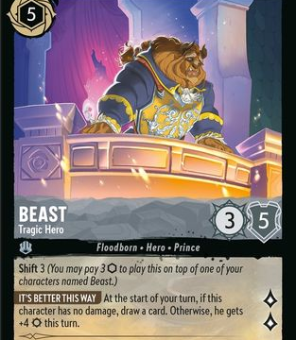
Testing the assumption:
The Assumption is that the game developers are good at their jobs and the colors are balanced. As such, my average win/loss ratio is going to be approximately the same regardless of color encountered.
The dependent variable is the resulting Win or Loss while the independent is the color combination encountered.

Slide 6
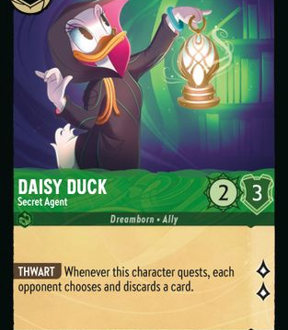
The test itself:
H_O: Mu(W:(<insert color here>)=.5
H_A:MU(W:(<insert same color here>)!=.5
I ran this for every color combination and then aggregated the individual colors and did the same...result:lots of tests.

Slide 7
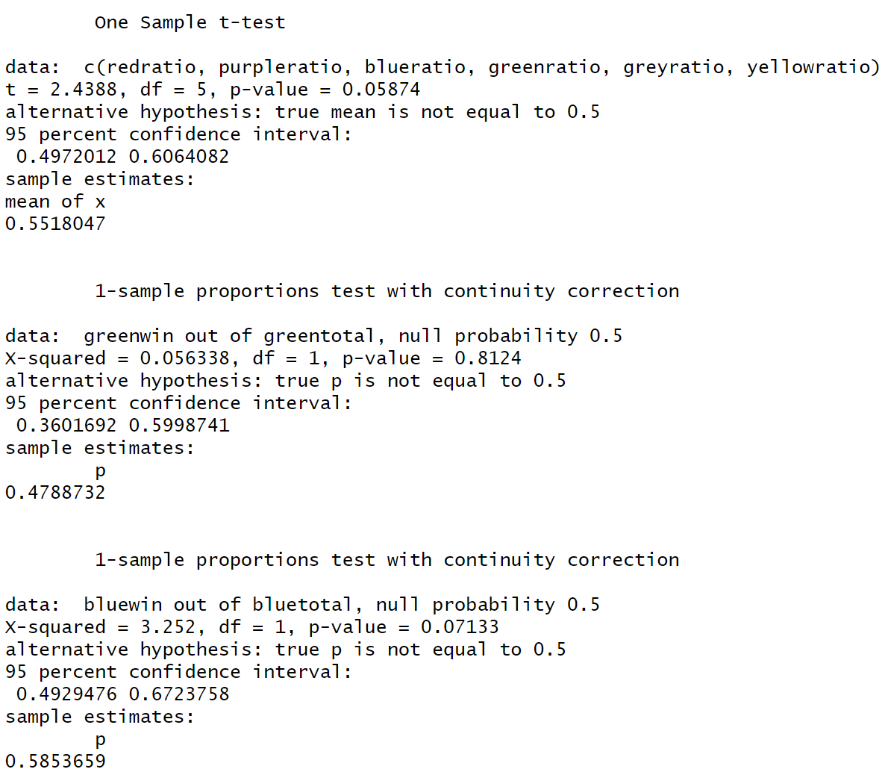
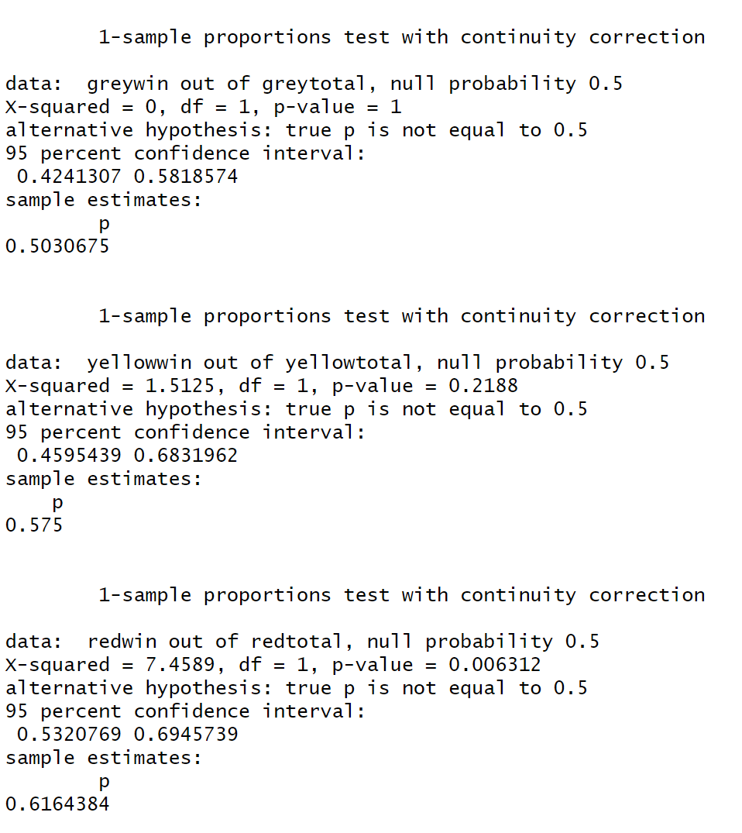
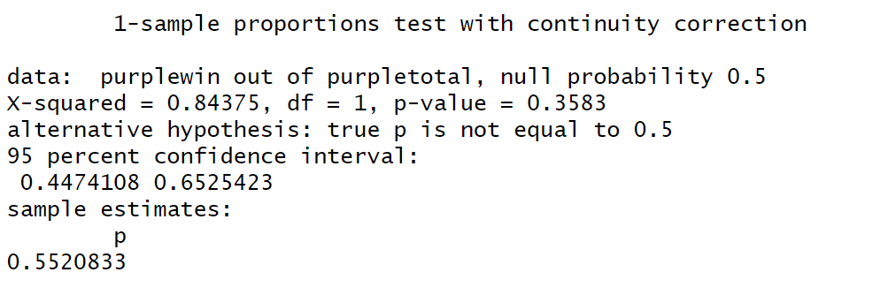

Slide 8
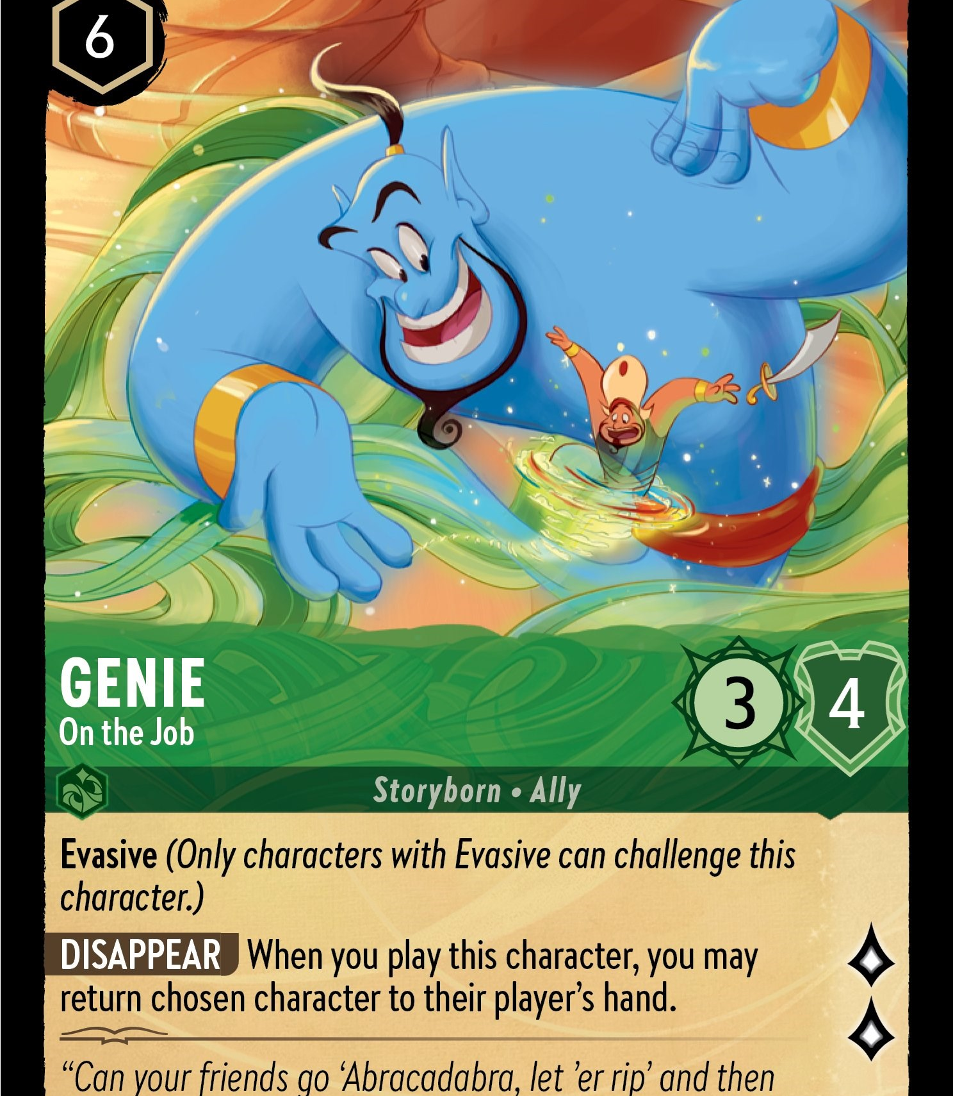
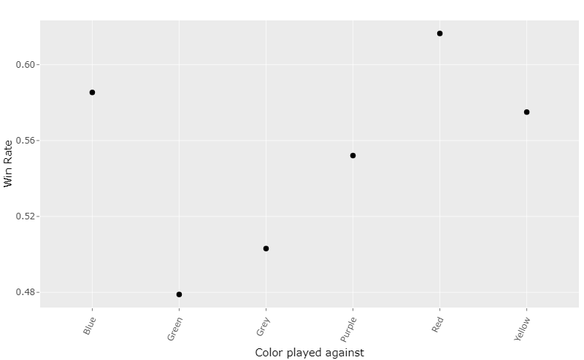
Conclusion:
Not accounting for me just being bad at the game, the initial T-test showed that after 342 games all the colors are roughly balanced. Although just barely, the true range of expected wins appears to be (.497 -.606). Of note, the only color that individually had it's null hypothesis rejected was Red. In which my true expected win ratio is between .532 and .695.

Slide 9
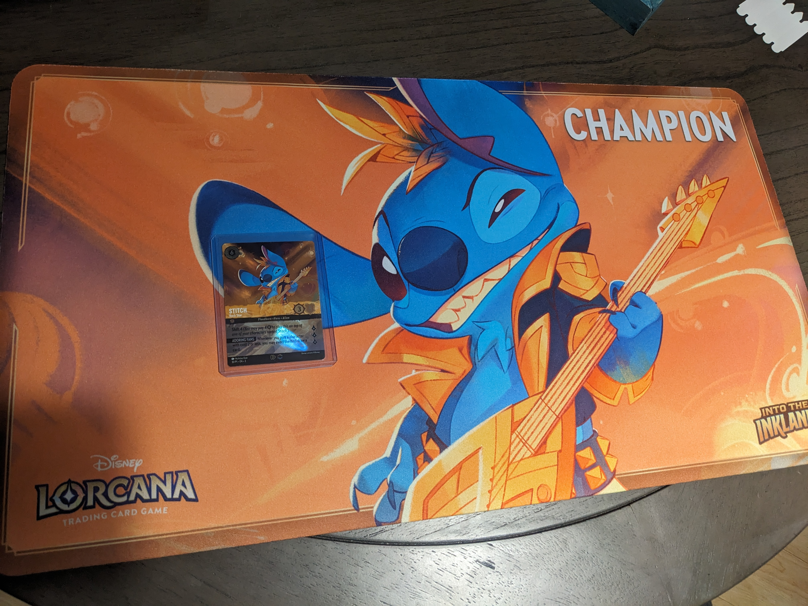
Follow up:
Huge success!!
The collected data allowed me to make game time decisions and play against my weaker colors more effectively.
I won the whole darn thing!
https://github.com/RawBananna/Lorcanaproject.git

